Slide 1


B.E Course in Software Engineering
MEHRAN UNIVERSITY
OF ENGINEERING & TECHNOLOGY, JAMSHORO, SINDH, PAKISTAN
Software Quality Engineering
Naeem A. Mahoto
naeemmahoto@gmail.com

Slide 2
Outlines
Structure of Client/Server Systems
Software Engineering for Client/Server Systems
Design of Client/Server Systems
Testing Issues

Slide 3
Structure of Client/Server Systems
In client server computing, the clients requests a resource and the server provides that resource.
A server may serve multiple clients at the same time while a client is in contact with only one server.
The different structures for two tier and three tier are given as follows:
Two - Tier Client/Server Structure
Three - Tier Client/Server Structure

Slide 4
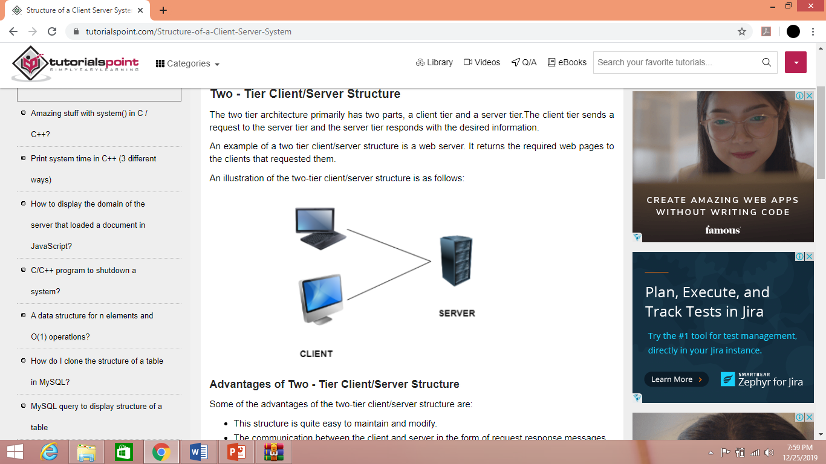
Structure of Client/Server Systems
The Two Tier Architecture primarily has two parts, a client tier and a server tier.
The client tier sends a request to the server tier and the server tier responds with the desired information.
An example of a two tier client/server structure is a web server. It returns the required web pages to the clients that requested them.

Slide 5
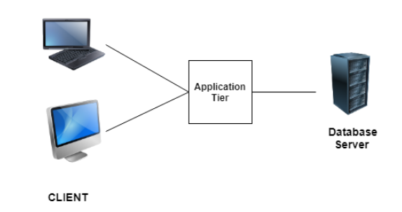
Structure of Client/Server Systems
The Three Tier Architecture has three layers namely client, application and data layer.
The client layer is the one that requests the information. In this case it could be the GUI, web interface etc.
The application layer acts as an interface between the client and data layer. It helps in communication and also provides security.
The data layer is the one that actually contains the required data.

Slide 6
Software Engineering for Client/Server Systems
Client/server software engineering blends conventional principles, concepts, and methods with elements of object-oriented and component-based software engineering.
C/S architectures dominate the landscape of computer-based systems. In C/S architectures, software residing on one computer (the client) requests services or data from another computer (the server).
The process model used in C/S software engineering is evolutionary beginning with requirements elicitation.
Functionality is allocated to subsystems of components that are assigned to either the client or the server side of the C/S architecture.
Design focuses on integration of existing components and creation of new components.
Implementation and testing must exercise both the­ client and server functionality within the context of the component integration standards and the C/S architecture.

Slide 7
Software Engineering for Client/Server Systems
C/S software engineering relies on the same SQA practices as other software engineering processes.
Formal technical reviews are used to assess the quality of the analysis and design models.
Specialized reviews consider issues associated with component integration and middleware.
Testing is used to uncover errors at the component, subsystem, client, and sever levels.

Slide 8
Software Engineering for Client/Server Systems
Representative Client/Server Systems
File servers
client requests selected records from a file, server transmits records to client over the network
Database servers
client sends SQL requests to server, server processes the request and returns the results to the client over the network
Transaction servers
client sends requests that invokes remote procedures on the server side, sever executes procedures invoked and returns the results to the client
Groupware servers
server provides set of applications that enable communication among clients using text, images, bulletin boards, video, etc.

Slide 9
Software Engineering for Client/Server Systems
Software Components for C/S Systems
User interaction/presentation subsystem
handles all user events
Application subsystem
implements requirements defined by the application within the context of the operating environment, components may reside on either the client or server side
Database management subsystem
performs data manipulation and management for the application
Middleware
all software components that exist on both the client and the server to allow exchange of information

Slide 10
Software Engineering for Client/Server Systems
Representative C/S Configuration Options
Distributed presentation
database and application logic remain on the server, client software is used to reformat server data into GUI format
Remote presentation
similar to distributed presentation, primary database and application logic remain on the server, data sent by the server is used by the client to prepare the user presentation
Distributed logic
client is assigned all user presentation tasks associated with data entry and formulating server queries, server is assigned data management tasks and updates information based on user actions
Remote data management
applications on server side create new data sources, applications on client side process the new data returned by the server
Distributed databases
data is spread across multiple clients and servers, requiring clients to support data management as well as application and GUI components
Fat server
most software functions for C/S system are allocated to the server
Thin clients
network computer approach relegating all application processing to a fat server

Slide 11
Software Engineering for Client/Server Systems
Guidelines for Distributing Application Subsystems
The presentation/interaction subsystem is generally placed on the client.
If the database is to be shared by multiple users connected by a LAN, the database is typically located on the server.
Static data used for reference should be allocated to the client.
Linking C/S Software Subsystems
Pipes (permit messaging between different machines running different operating systems)
Remote procedure calls (permit process running on one machine to invoke execution of process residing on another machine)
Client/server SQL interaction (SQL requests passed from client to server DBMS, this mechanism is limited to RDBMS)
Representative Middleware Architectures
CORBA (ORB)
COM (Microsoft)
JavaBeans (Sun)

Slide 12
Design for Client/Server Systems
Architectural Design for Client/Server Systems
Best described as communicating processes style architecture whose goal is to achieve easy scalability when adding and arbitrary number of clients
Since modern C/S systems tend to be component-based, an object request broker (ORB) architecture is used for implementation
Object adapters or wrappers provide service to facilitate communication among client and server components
component implementations are registered
all component references are interpreted and reconciled
component references are mapped to corresponding component implementations
objects are activated and deactivated
operations are invoked when messages are transmitted
security features are implemented

Slide 13
Design for Client/Server Systems
Data and architectural design
dominates the design process to be able to effectively use the capabilities of RDBMS or OODMBS
Event-driven paradigm
when used, behavioral modeling should be conducted and the control-oriented aspects of the behavioral model should translated into the design model
Interface design
elevated in importance, since the user interaction/presentation component implements all functions typically associated with a GUI
Object-oriented point of view
often chosen, since an object structure is provided by events initiated in the GUI and their event handlers within the client-based software

Slide 14
Design for Client/Server Systems
C/S Design Repository Information
Entities (from ER diagram)
Files (which implement entities)
File-to-field relationship (establishes file layout)
Fields (from data dictionary)
File-to-file relationships (related files that may be joined together)
Relationship validation
Field type (used to permit inheritance from super classes)
Data type (characteristics of field data)
File type (used to identify file location)
Field function (key, foreign key, attribute, etc.)
Allowed values
Business values (rules for editing, calculating derived fields, etc.)

Slide 15
Design for Client/Server Systems
Data Distribution and Management Techniques
Relational data base management systems (RDBMS)
Manual extract (user allowed to manually copy data from server to client)
Snapshot
Replication (multiple copies of data are maintained at different sites)
Fragmentation (system database is spread across several machines)
C/S Design Approach
For each elementary business process, identify the files created, updated, referenced, or deleted.
Use the files from step 1 as basis for defining components or objects.
For each component, retrieve the business rules and other business object information that has been established for the relevant file.
Determine which rules are relevant to the process and decompose the rules down to the method level.
As required, define any additional components that are needed to implement the methods.

Slide 16
Design for Client/Server Systems
Process Design Entities
Methods - describe how a business rule is to be implemented
Elementary processes - business processes identified in the analysis model
Process/component link - identifies components that makeup the solution for an elementary business process
Components - describes components shown on structure chart
Business rule/component link - identified components significant to implementation of a given business rule

Slide 17
Testing Issues
WebApp testing is more challenging than conventional software testing.
WebApps operate on several OS, browsers, hardware, platforms, communication protocols.
Most WebApp errors are initially detected on ‘client side’.
Content model is reviewed to uncover errors.
Design model is reviewed to uncover navigational errors.

Slide 18
Testing Web Applications
Dimensions of Quality
Content
Function
Structure
Usability
Navigability
Performance
Compatibility
Interoperability
Security

Slide 19
Testing Web Applications
Content Testing
Static Content Testing
Dynamic Content Testing (Database Testing)
User Interface Testing
Test links, forms, client side scripting, dynamic HTML, pop-windows, CGI scripts, streaming content, cookies, application specific interface mechanisms
Testing interface semantics
Usability tests
Compatibility tests

Slide 20
Testing Web Applications
Component Level Testing
Equivalence partitioning
Boundary value analysis
Path testing
Navigation Testing
Navigation syntax
Navigation semantics
Configuration Testing
Server side issues
Client side issues

Slide 21
Testing Web Applications
Security Testing
Firewall
Authentication
Encryption
Authorization
Performance Testing
Load testing
Stress testing

Slide 22
Testing Issues
C/S Testing Strategy
Application function tests
client applications tested in stand alone manner
Server tests
test coordination and management functions of server, also measure performance of server
Database tests
check accuracy and integrity server data, examine transactions posted by client, test archiving
Transaction testing
ensure each class of transactions is processed correctly
Network communication testing
verify communication among network nodes
C/S Testing Tactics
Begins with testing in the small and then proceeds to integration testing using the non-incremental or big bang approach
Requires special attention to configuration testing and compatibility testing
OO testing tactics can be used for C/S systems (even when system was not built using OO methodology)
GUI testing requires special techniques in C/S systems (e.g. structured capture/playback)

